Slide 1



EMPLOYEE DATA ANALYSIS USING EXCEL
‹#›
STUDENT NAME: V C SUDHARSAN
REGISTER NO: 413ABFD6E2DA5DC973844F697B68F266
DEPARTMENT: COMMERCE
COLLEGE: DRBCCC HINDU COLLEGE
Notes:
1.7.2013
1
‹#›

Slide 2


PROJECT TITLE
Employee Salary Analysis using Excel.

Slide 3
AGENDA:
Problem Statement
Project Overview
End Users
Our Solution and Proposition
Dataset Description
Modelling Approach
Results and Discussion
Conclusion

Slide 4



PROBLEM STATEMENT
ANALYZING EMPLOYEE SALARIES HELPS ENSURE FAIR COMPENSATION, IDENTIFY WAGE DISPARITIES, AND ALIGN PAY STRUCTURES WITH INDUSTRY STANDARDS. IT ALSO AIDS IN BUDGETING AND FINANCIAL PLANNING, ENSURING THAT SALARY EXPENSES ARE SUSTAINABLE.

Slide 5

PROJECT OVERVIEW
THE EMPLOYEE SALARY ANALYSIS PROJECT AIMS TO EVALUATE AND OPTIMIZE EMPLOYEE COMPENSATION WITHIN THE ORGANIZATION. THIS INVOLVES COLLECTING, CLEANING, AND ANALYZING SALARY DATA TO IDENTIFY TRENDS, DISPARITIES, AND CORRELATIONS WITH FACTORS SUCH AS JOB ROLES, PERFORMANCE, AND EXPERIENCE. THE ANALYSIS WILL HELP ENSURE COMPETITIVE AND FAIR COMPENSATION, INFORM HR POLICIES, AND SUPPORT BUDGET PLANNING. THE PROJECT WILL CONCLUDE WITH ACTIONABLE INSIGHTS AND RECOMMENDATIONS FOR SALARY ADJUSTMENTS.

Slide 6


WHO ARE THE END USERS?
-HUMAN RESOURCES(HR)
-MANAGEMENT & EXECUTIVES
-FINANCE DEPARTMENT
-TEAM LEADER
-EMPLOYEES

Slide 7


OUR SOLUTION AND ITS VALUE PROPOSITION
CONDITIONAL FORMATTING-SALARY
FILTER-REMOVE
FORMULA-PERFROMANCE
GRAPH- DATA VISUALIZTION

Slide 8
DATASET DESCRIPTION
EMPLOYEE DETAILS-KAGGLE.COM
30-FEATURES
11-FEATURES
NAME-TEXT
JOINING YEAR-NUMBERS
GENDER-MALE OR FEMALE
AGE-NUMBERS
SALARY-NUMBERS
WORK LOCATION-TEXT
EMPLOYEE RATING-NUMBERS
PERFORMANCE-TEXT

Slide 9
MODELLING
DATA COLLECTION:
●COLLECTED FROM KAGGLE.
FEATURE COLLECTION:
●CONDITIONAL FORMATTING
● SYMBOLS
●MERGE&CENTER
PERFORMANCE LEVEL:
●WITH USING EMPLOYEE RATING COLUNM TO GET PERFORMANCE LEVEL.
‹#›

Slide 10
SUMMARY:
● TO FIND THE SALARY OF THE EMPLOYEE BY USING THE EXCEL
●THE RESULTS SHOWN IN THE GRAPH.

Slide 11
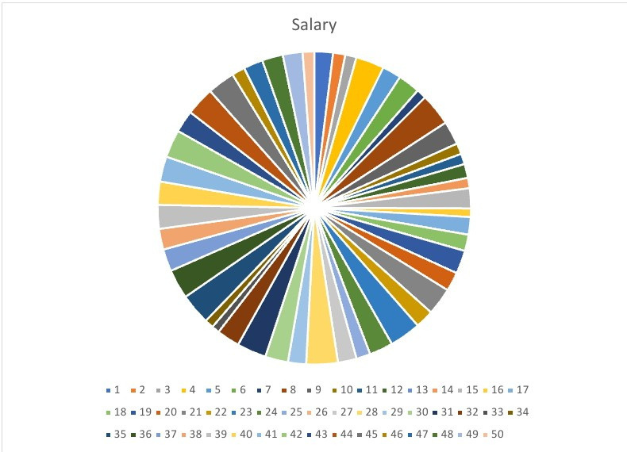
RESULTS:
‹#›

Slide 12
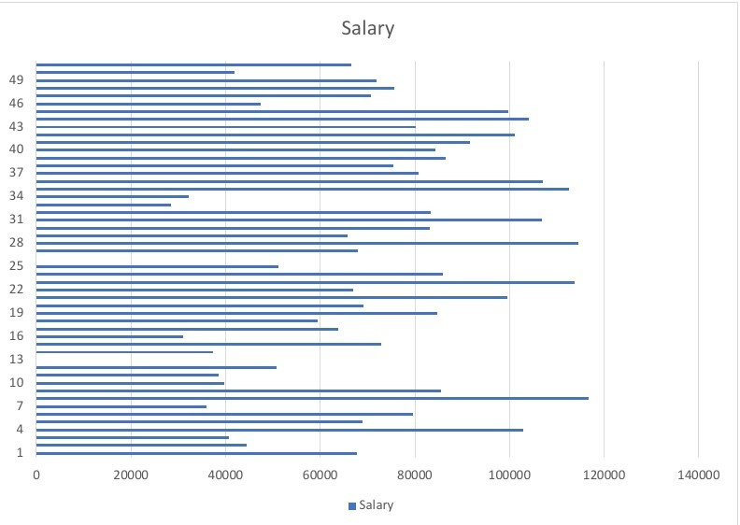
RESULT:

Slide 13
CONCLUSION:
IN THIS SALARY ANALYSIS THE SOME
OF EMPLOYEES ARE GET HIGHER
SALARY IN THE DEPARTMENT OF
QUALITY AND SALES.

